Slide 1

New Age Boosting Algorithms
Talamanchi Reddy
Pranay Tiwari

Slide 2
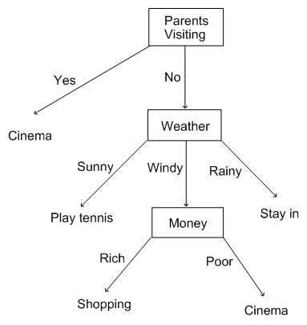
What do people do on weekends?
Decision Trees-Recap

Slide 3
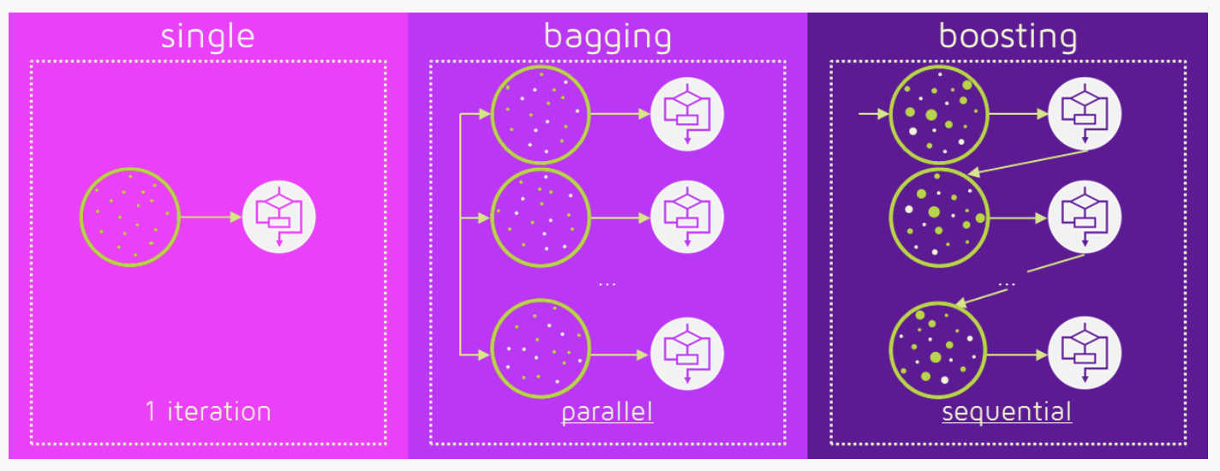
Tree Based Methods

Slide 4
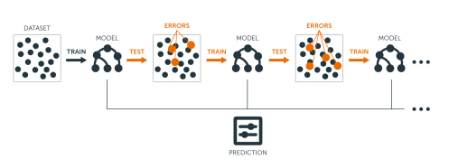
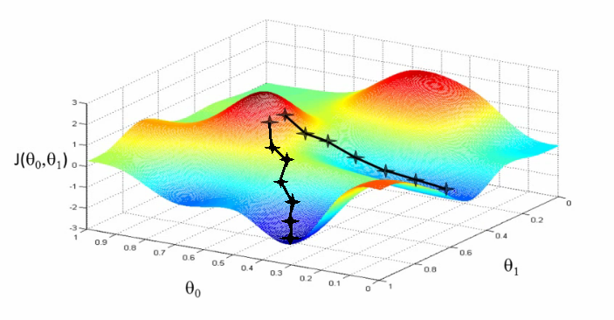
Gradient Descent + Boosting= Gradient Boosting
+
Gradient Boosting
Wikipedia Definition
Gradient boosting is a machine learning technique for regression and classification problems, which produces a prediction model in the form of an ensemble of weak prediction models, typically decision trees. It builds the model in a stage-wise fashion like other boosting methods do, and it generalizes them by allowing optimization of an arbitrary differentiable loss function.

Slide 5
XGBoost

Slide 6
XGBoost owes its intial popularity to Kaggle
“When in doubt, use XGBoost” - Avito Winner’s Interview: 1st place, Owen Zhang
“I love single models that do well, and my best single model was an XGBoost that could get the 10th place by itself.” - Caterpillar Winners’ Interview: 1st place
As the winner of an increasing amount of Kaggle competitions, XGBoost showed us again to be a great all-round algorithm worth having in your toolbox. - Dato Winners’ Interview: 1st place, Mad Professors
https://github.com/dmlc/xgboost/tree/master/demo#machine-learning-challenge-winning-solutions

Slide 7
What is XGBoost
XGBoost ~ Gradient Descent + Boosting + Regularization
“Both xgboost and gbm follows the principle of gradient boosting. There are however, the difference in modeling details. Specifically, xgboost used a more regularized model formalization to control over-fitting, which gives it better performance…. For model, it might be more suitable to be called as regularized gradient boosting.” – Tianqui Chen, creator of the XGBoost package

Slide 8
What is regularization?
A model objective function contains two parts – training loss and regularization
Obj(ᶿ) = L(ᶿ) + Ω(ᶿ)
Training loss function - Measures how close is my predicted y to the actual y in the training set
e.g. ∑(y – ŷ)²
Regularization - Measures the complexity of the model
XGBoost handles regularization very effectively
https://syncedreview.com/2017/10/22/tree-boosting-with-xgboost-why-does-xgboost-win-every-machine-learning-competition/

Slide 9
Other advantages of XGBoost
Parallel Computing
Missing Values
Enabled Cross Validation
Flexibility
Availability
https://www.hackerearth.com/practice/machine-learning/machine-learning-algorithms/beginners-tutorial-on-xgboost-parameter-tuning-r/tutorial/

Slide 10
Objective –
reg:linear - for linear regression
binary:logistic - logistic regression for binary classification. It returns class probabilities
Booster Parameters –
nrounds
eta – the learning rate
gamma – controls regularization
max_depth – controls the depth of the tree
subsample - subsample ratio of the training instance
colsample_bytree - It control the number of features (variables) supplied to a tree
XGBoost parameters
eval_metric –
AUC - Area under curve (used in classification)
RMSE - Root mean square error (used in regression)
https://github.com/dmlc/xgboost/blob/master/doc/parameter.md

Slide 11




XGBoost parameter tuning
Parameter tuning is essential if we want to build a good model
Baseline XGBoost model
XGBoost with Cross validation
Cross Val + Parameter tuning

Slide 12
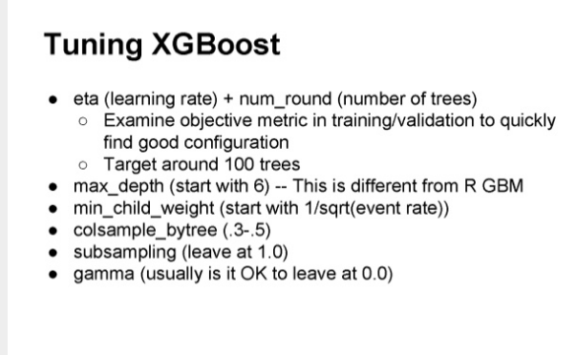
XGBoost parameters Thumb rules
https://www.youtube.com/watch?v=7YnVZrabTA8

Slide 13

Light GBM

Slide 14
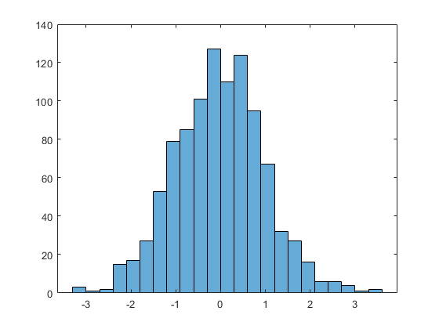
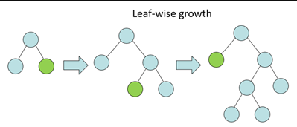
+
LightGBM ~Gradient Descent+ Boosting+ Regularization +
Advantages
Light GBM
Handles Missing Values
Automatic handling of Categorical variables
Faster training than XGBoost
Often better results on larger datasets

Slide 15
Light GBM Key Parameters
application: This is similar to objective in XGBoost
regression: for regression
binary: for binary classification
multiclass: for multiclass classification problem
num_boost_round
learning_rate
max_depth
num_leaves
max_bin
categorical_feature
early_stopping_round
lambda
min_gain_to_split
Key Parameters
Metric : Evaluation metric for the model
AUC - Area under curve (used in classification)
RMSE - Root mean square error (used in regression)

Slide 16
XGBoost has recently implemented histogram based split similar to LightGBM for faster boosting
Parameters to set for XGBoosting the LightGBM way
treemethod=‘hist’
max_bins= Maximum number of discrete bins to bucket continuous features
XGBoosting LightGBM way

Slide 17



Conclusion
Complex models may help reduce the training error but regularization may be needed to prevent over -fitting
XGBoost and LightGBM are not just for Kaggle
Parameter tuning is important to build a good model

